Slide 1
EE405A Robotics Operating System (ROS) - 1
(TA) Hyunki Seong
School of Electrical Engineering
KAIST
March 12, 2021
hynkis@kaist.ac.kr

Slide 2
Experiment Objectives
In this week, you will do the following:
Get brief tips on installing Ubuntu(Linux-based OS).
Understand the Robotics Operating System (ROS).
Install & Setup ROS.
Run ROS tutorial.
2
Notes:
(read)
- Okay so lets move on to ubuntu installation.

Slide 3
Ubuntu Installation
3
Notes:
- Okay so lets move on to ubuntu installation.

Slide 4
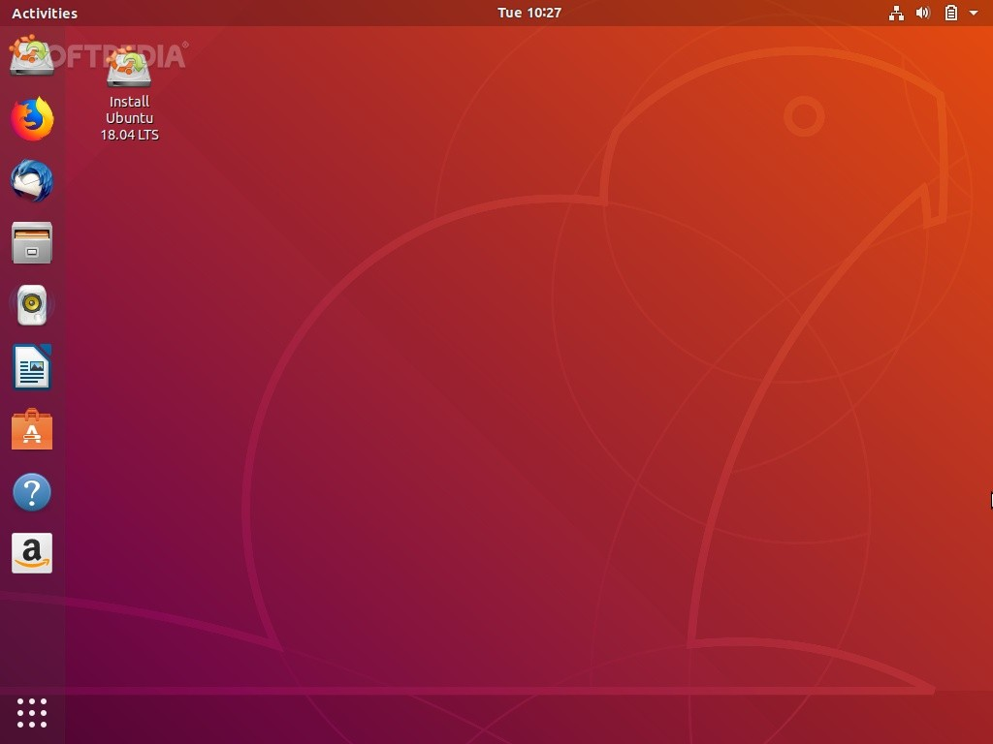
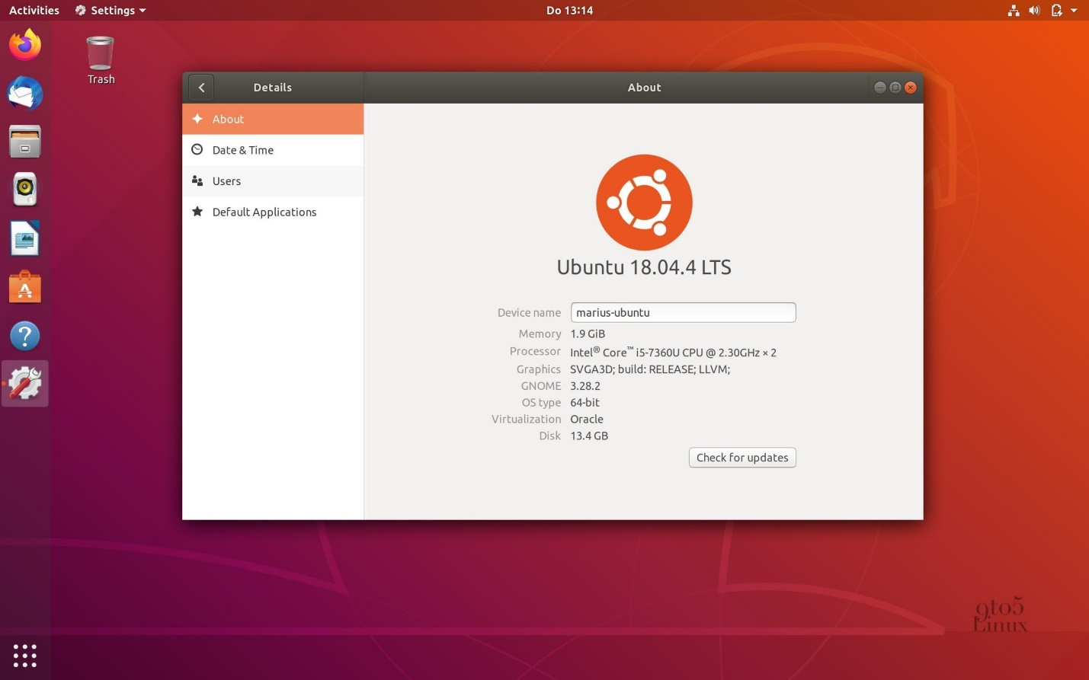
Ubuntu Installation
Ubuntu 18.04
Ubuntu is a Linux kernel-based Operating System(OS).
It is the most popular developer OS for personal desktops and laptops.
Recently, Ubuntu 18.04 release version is suitable for use.
Several figures from the Ubuntu 18.04 desktop
4
Notes:
Ubuntu is a Linux-based Operating System, which is different from the Window OS we already know.
Why do we need to use Ubuntu? Because It is the most popular developer OS for personal desktops and laptops.
Recently, Ubuntu 18.04 release version is suitable for use.

Slide 5
Ubuntu Installation
Ubuntu 18.04 Installation
There are two ways of Ubuntu Installation in your PC.
1. Install the Ubuntu alongside with Window in Dual Boot.
Link(Eng) : https://www.itzgeek.com/how-tos/linux/ubuntu-how-tos/how-to-install-ubuntu-18-04-alongside-with-windows-10-or-8-in-dual-boot.html
Link(Kor) : https://coding-factory.tistory.com/494
2. Install the Ubuntu in a Virtual Machine.
Link(Eng) : https://codebots.com/library/techies/ubuntu-18-04-virtual-machine-setup
We strongly recommend you install Ubuntu in Dual Boot (The virtual machine is too heavy and slow.)
5
Notes:
(read sentence)
- Dual boot means you can choose the OS before booting your PC.
- There are some recommended links for installation. Please refer these links when you install the ubuntu in your PC.

Slide 6
Background
1. Robotics Operating System (ROS)
2. Node, Topic, Publish/Subscribe
3. Applications of ROS
6
Notes:
And that’s it.
There are already many references to install ubuntu, so this is all we prepared.
Let’s quickly move on to the background about ROS system.
Which is the most important part in this week.

Slide 7

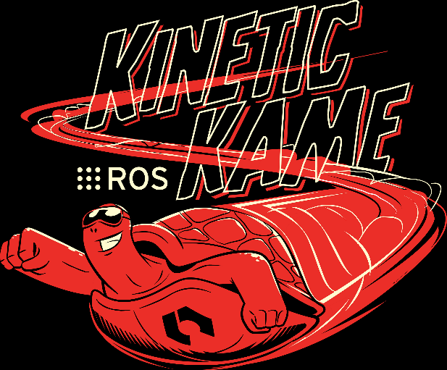


Robotics Operating System(ROS)
What is ROS?
The Robot Operating System(ROS) is a flexible framework for writing robot software.
It is a collection of tools, libraries, and conventions that aim to simplify the task of creating complex and robust robot behavior across a wide variety of robotic platforms.
It has a large ecosystem to encourage collaborative robotics software development.
ROS distributions for Ubuntu 16.04(Kinetic), 18.04(Melodic), 20.04(Noetic)
ROS for robotics software development
7
Notes:
(read sentense)
- ~~~
- ~~~
- It has a large ecosystem, which means there are a lot of open source, to encourage collaborative robotics software development.

Slide 8
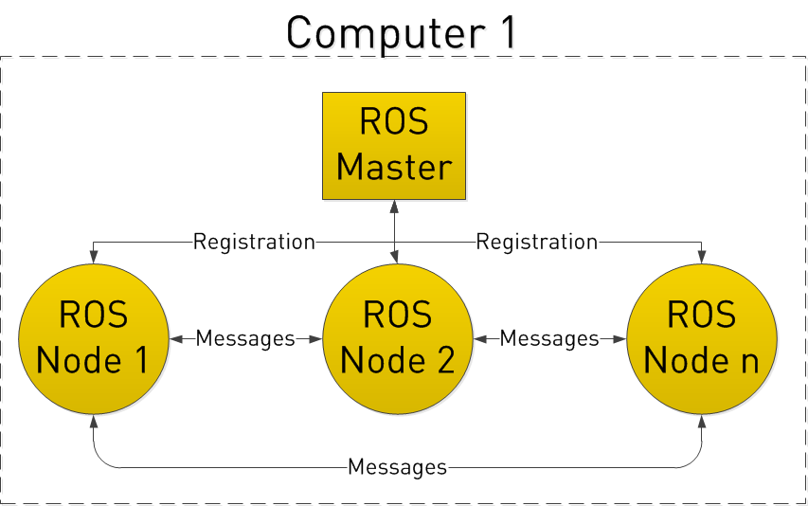
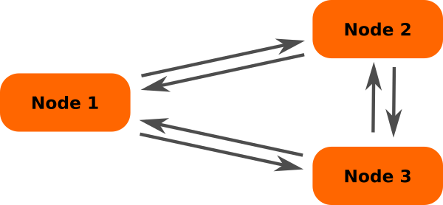
Robotics Operating System(ROS)
What is ROS?
A robot system
8
Notes:
Simply speaking, ROS is a Network system to run a robotic system.
There can be several ROS nodes and each node can send some data as messages to other nodes and also can receive some data from other nodes.
All these message communication is implemented by the ROS Master node.
Because it has all the registration information of the ROS nodes in this robotic system.

Slide 9
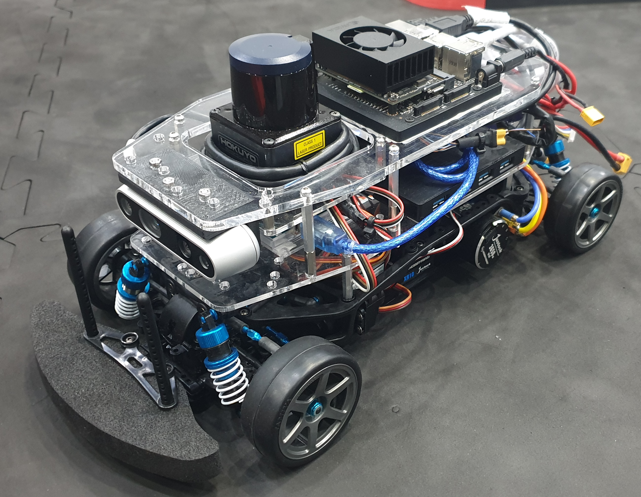
Robotics Operating System(ROS)
What is ROS?
Jetson NX2
LiDAR
(Hokuyo UST-20LX)
IMU
(myAHRS+)
Camera
(Realsense D435i)
Controller
(Arduino)
Notes:
Let me give you an example.
This is a vehicle platform you will use later.
In this vehicle, there are some sensors, Jetson, which is the main computer, and Arduino which is the controller.
All these are the hardware system.

Slide 10
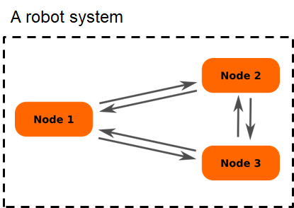
Robotics Operating System(ROS)
What is ROS?
A vehicle system
Sensor Interface
Perception
Planning & Control
RC Car Platform
Camera interface
Object Detection
Motion Planner
LiDAR interface
Pose estimation
Steering Control
Control interface
IMU interface
Throttle Control
Servo motor
DC motor
“Subscribe to a message
whose name is ‘/topic_A’.”
“Publish message
whose name is ‘/topic_B’.”
/topic_A
ROS
Node
/topic_B
10
Notes:
What about the software system of this vehicle?
it has a software configuration looks like this.
It has sensor interfaces, perception modules, planning and control modules and control interface.
Each block is exactly same with the ROS node.
The Camera interface node send camera images to the Object detection node,
The Object detection node receive the image and send detect results to motion planner
And the control node get some path or decision from the motion planner and output some control commands.
In ROS, we describe the data communication between the nodes as the below figure.
A ROS node receive a topic A data, which is said “subscribe to a message whose name is ‘topic_A’.
And this node send or broadcast a topic A data, which is said “publish a message whose name is ‘topic_B’.
So, all the blocks in this vehicle system is equivalent to the ROS nodes, and there can be message communication between ROS nodes in a robotic system.
ROS has good tools and libraries for designing this kind of robot software system.

Slide 11
Robotics Operating System(ROS)
Important terminologies in ROS
Node
Master
Message
Topic
Bag
Reference : http://www.clearpathrobotics.com/assets/guides/kinetic/ros/Intro%20to%20the%20Robot%20Operating%20System.html
11
Notes:
There are some important terminologies in ROS.

Slide 12
Robotics Operating System(ROS)
Concepts
ROS is processed in the peer-to-peer network that are processing data together.
Important terminologies: Node, Master, Message, Topic, Bag, …
Nodes : Nodes are processes that perform computation. A robotic system will usually comprise many nodes; one node to control a laser range-finder, one node to control wheel motors, one node to perform localization, control, and so on.
Master : Master provides name registration of all nodes and lookup information, much like a DNS server.
Message : Nodes communicate with each other by passing messages. A message is simply a data structure, comprising typed fields.
Topic : The topic is a name that is used to identify the content of the message.
Bags : Bags are a format for saving and playing back ROS message data. Bags are important mechanism for storing data, such as sensor data, that can be difficult to collect but is necessary for developing and testing algorithms.
Reference : http://library.isr.ist.utl.pt/docs/roswiki/ROS(2f)Concepts.html
Notes:
This is the explanation of each terminology.
But It’s pretty wordy, so please read this later in detail.

Slide 13
Robotics Operating System(ROS)
ROS Master stores topics registration information for ROS nodes. Nodes communicate with the Master to report their registration information.
Nodes connect to other nodes directly; the Master only provides lookup information, much like a DNS server.
※ registration info : node name, msg info to publish, msg info to subscribe, …
Reference : http://www.clearpathrobotics.com/assets/guides/kinetic/ros/Intro%20to%20the%20Robot%20Operating%20System.html
13
Notes:
So, ROS master

Slide 14
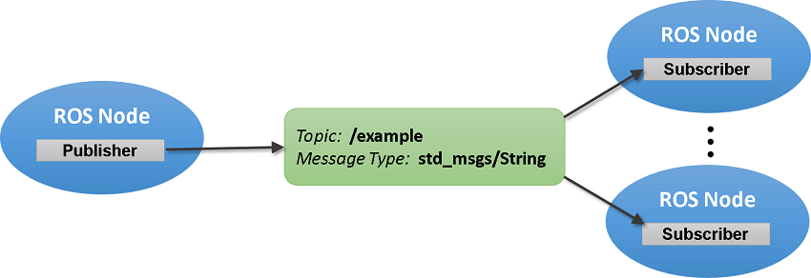
Robotics Operating System(ROS)
Message, Topic
Messages are routed via a transport system with publish / subscribe semantics.
In message type, standard primitive types (Integer, Floating point, Boolean, etc.) are supported, as are arrays of primitives types.
Messages can be arbitrary nested structures and arrays (much like C structs).
Topic = Name of the message
Reference : https://kr.mathworks.com/help/ros/ug/exchange-data-with-ros-publishers-and-subscribers.html
14
Notes:
- Messages are routed via a transport system with Publish and Subscribe semantics.
- And the message has a message type, such as String, Float, Int, and etc.
- Also the message type can be a struct or array, just like a struct in C language.

Slide 15
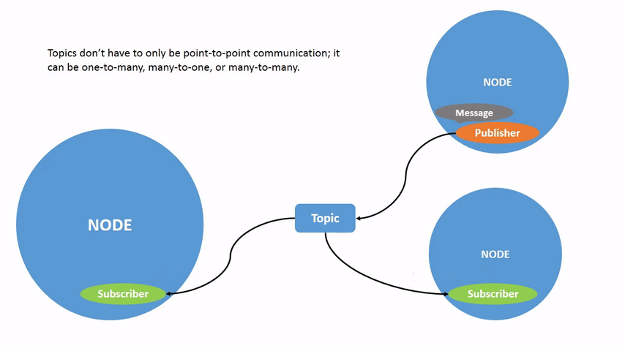
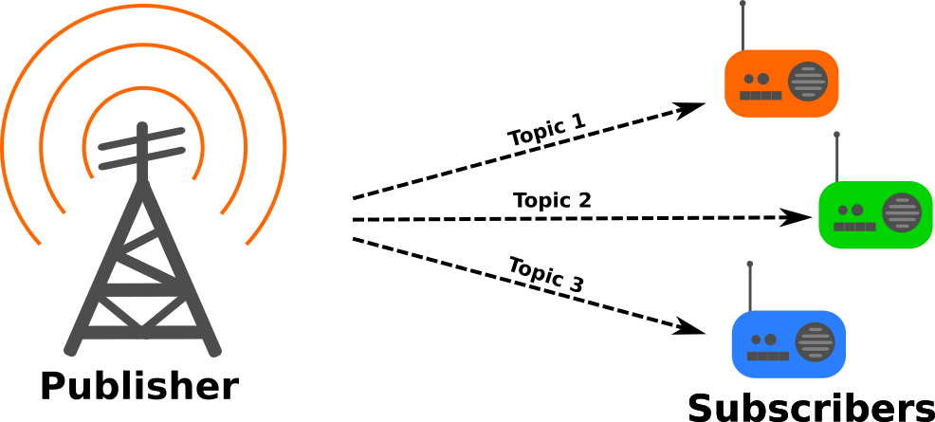
Robotics Operating System(ROS)
Publish / Subscribe
A node sends out a message by publishing(=broadcasting) it to a given topic.
A node that is interested in a certain kind of data will subscribe to(=receive) the appropriate topic.
There may be multiple concurrent publishers and subscribers for a single topic, and a single node may publish and/or subscribe to multiple topics.
→ It can be One-to-One, One-to-Many, or Many-to-Many communication!
Reference : https://davesroboshack.com/the-robot-operating-system-ros/overview-of-ros/
15
Notes:
- Publishing is a kind of broadcasting a message with its own topic name, Topic 1, 2, or 3.
So that some nodes can receive, or subscribe to the message by using its own topic name.
- This means it can be One-to-One, One-to-Many, or Many-to-Many communication between the ROS nodes.

Slide 16
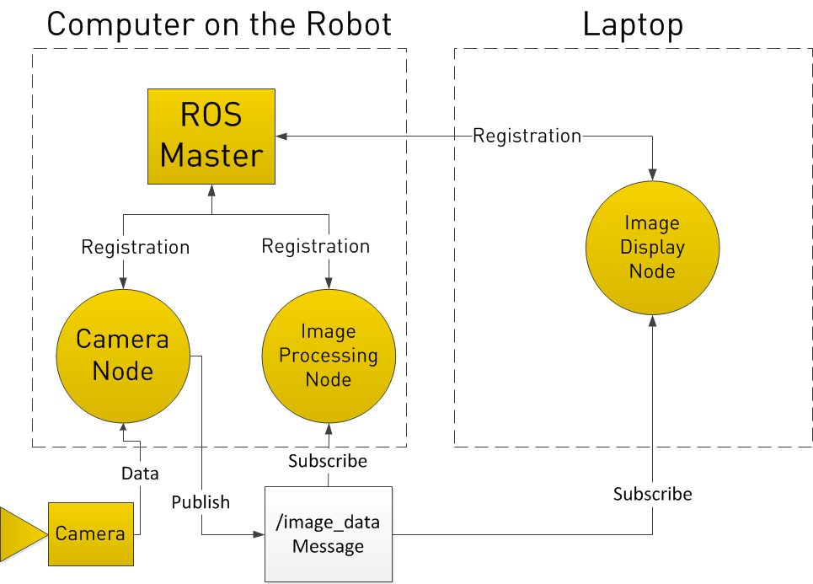
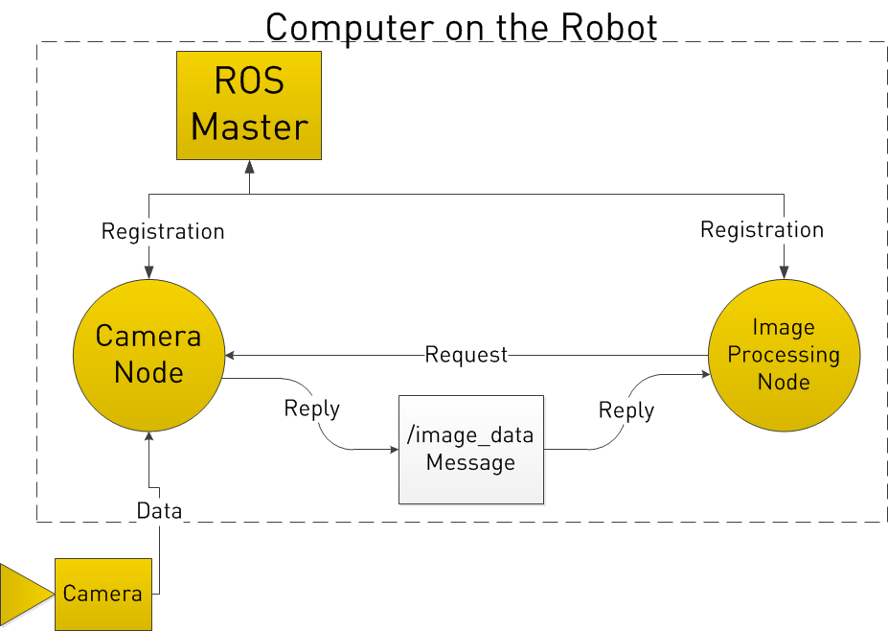
Robotics Operating System(ROS)
Example: Image processing with Camera node
There is a Camera Node to control a camera and receive image streaming data.
There is an Image Processing Node to process images from the camera.
Both nodes are registered to ROS Master node and data communication is established between them.
Camera Node publishes image data by the topic name ‘/image_data’, and the Image Processing Node subscribes the topic message whose topic name is ‘/image_data’ to process the image.
Another Node can be added to display the image data by subscribing the topic ‘/image_data’ at the Image Display Node.
Reference : http://www.clearpathrobotics.com/assets/guides/kinetic/ros/Intro%20to%20the%20Robot%20Operating%20System.html
16
Notes:
This is another example of ROS system.
(read sentence)

Slide 17
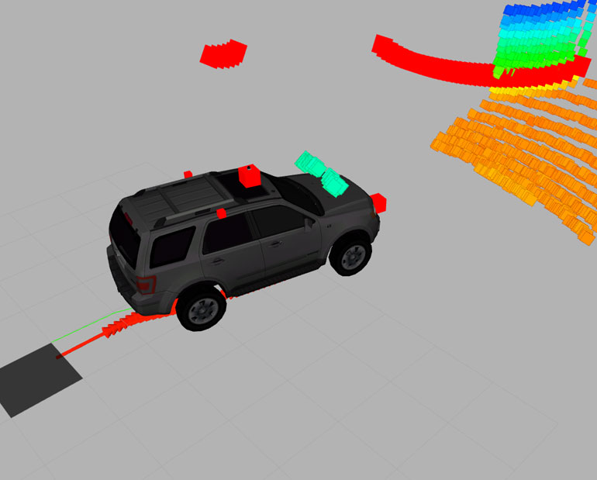
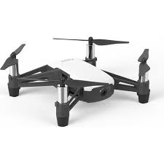
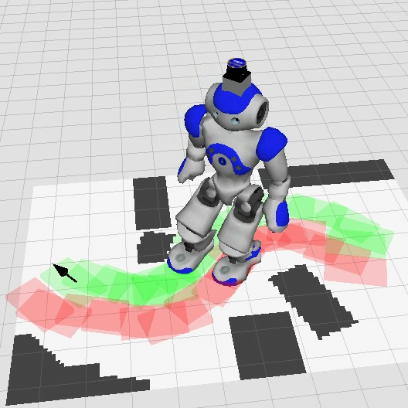
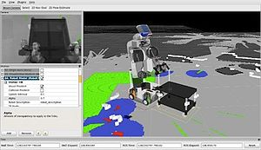
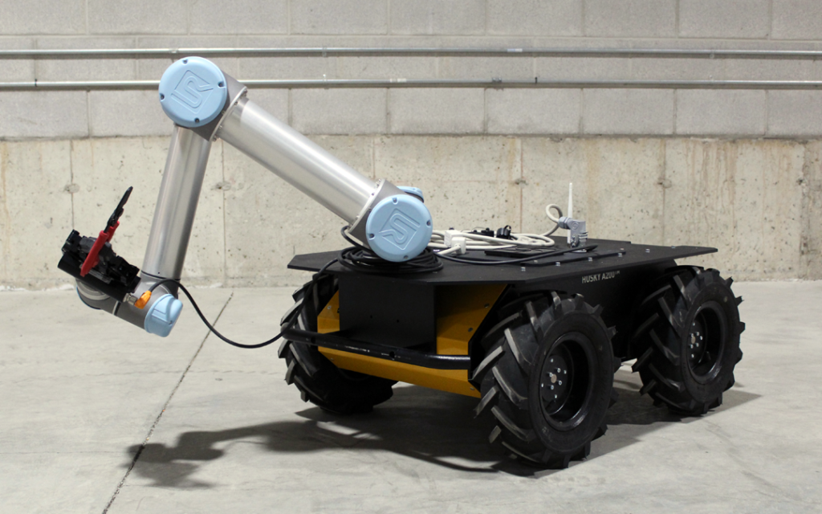
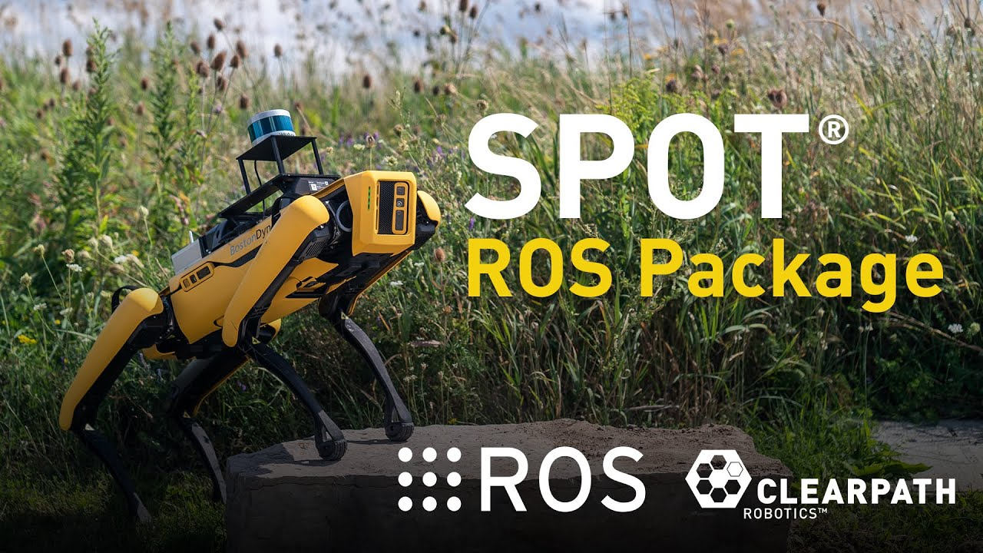
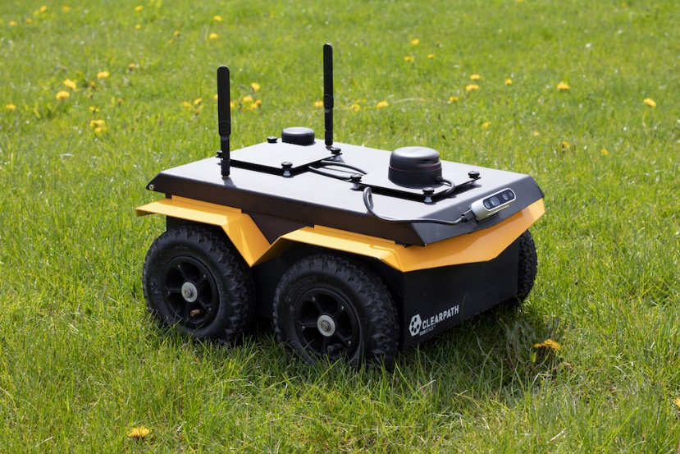
Applications of ROS
17
Notes:
There are many robotics applications which use the ROS system.
From the autonomous vehicle, drone, humanoid robot, wheeled vehicle, and the Spot which is one the most famous legged robot in the world.
All of them can be designed and controlled by ROS-based system
And there are many open source that we can easily use and apply our own robot system.

Slide 18
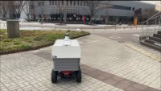

Applications of ROS
ROS Application for an Autonomous Delivery Robot [1]
ROS Application for a Drone Challenge [2]
[1] : https://www.youtube.com/watch?v=YmQ2W5y8cwU
[2] : https://www.youtube.com/watch?v=9UYjUIWnzwQ
18
Notes:
Our lab actively use the ROS.
Our autonomous delivery robot is based on the ROS system.
The robot use a Lidar sensor, localize(estimate where the robot is in a map), follow a path or waypoints
Also drone system is designed by ROS,
It has lidar and camera sensors, all the sensor interfaces are communicated by the ROS.
Some algorithms in the drone do motion planning and control for obstacle avoidance by subscribing the sensor data through the ROS system.

Slide 19
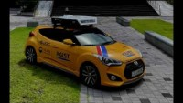
Applications of ROS
Example of ROS Application for Urban Autonomous Driving [1]
[1] : https://www.youtube.com/watch?v=qfV3RK9moy4&t=6s
19
Notes:
And This is our ROS-based autonomous vehicle system.
In this case, there can be a camera interface node, lane detection node, object detection and tracking node, control interface node, and etc.
So, as you can see, in a robotic system, there can be many nodes and each node can communicate each other by Publishing and Subscribing to some messages.
And each message has its own topic name, so that each ROS node can specify which message to publish or subscribe.

Slide 20
ROS Tutorial
1. Installation & Configuration of ROS
2. ROS Package Tutorial
3. ROS Topic
4. ROS Commands
20
Notes:
Until Now, we have learned the basic concept of ROS system.
Is there any question about ROS?
If you have, please write your question to the chat window.
We have learned small part of the ROS system,
So please study more the ROS yourself, not all the things in ROS but just some terminologies, tools, and codes.
And I strongly recommend you install the linux and ROS in your PC to be familiar with them.
They are the most fundamental things for your robotic programming.
(~Q&A~)
Ok from here, I will explain about the ROS in linux system.
For that I made a remote connection with my linux PC.
I will follow rest of this class by demonstrating in the linux environment.

Slide 21
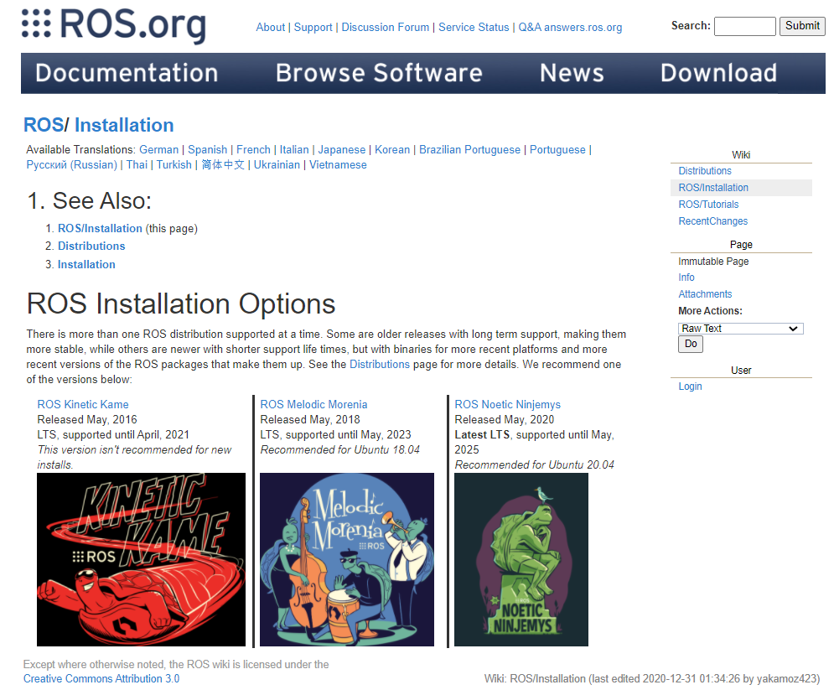
Installation & Configuration of ROS
Simply follow the homepage installation tutorial.
Install homepage: http://wiki.ros.org/ROS/Installation.
ROS Kinetic (for Ubuntu 16.04)
ROS Melodic (for Ubuntu 18.04)
21

Slide 22
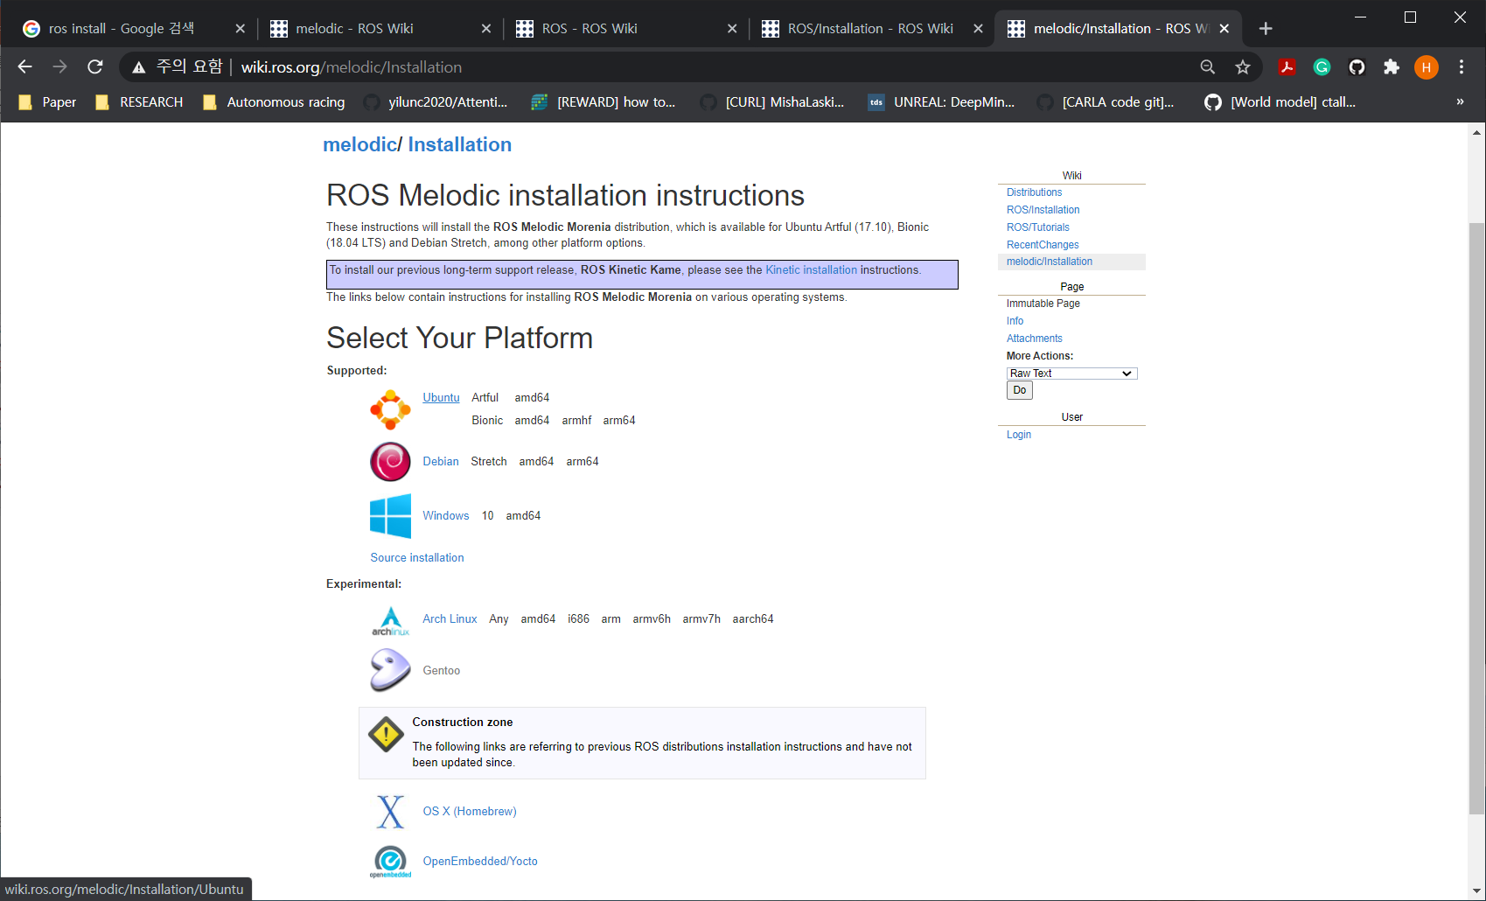
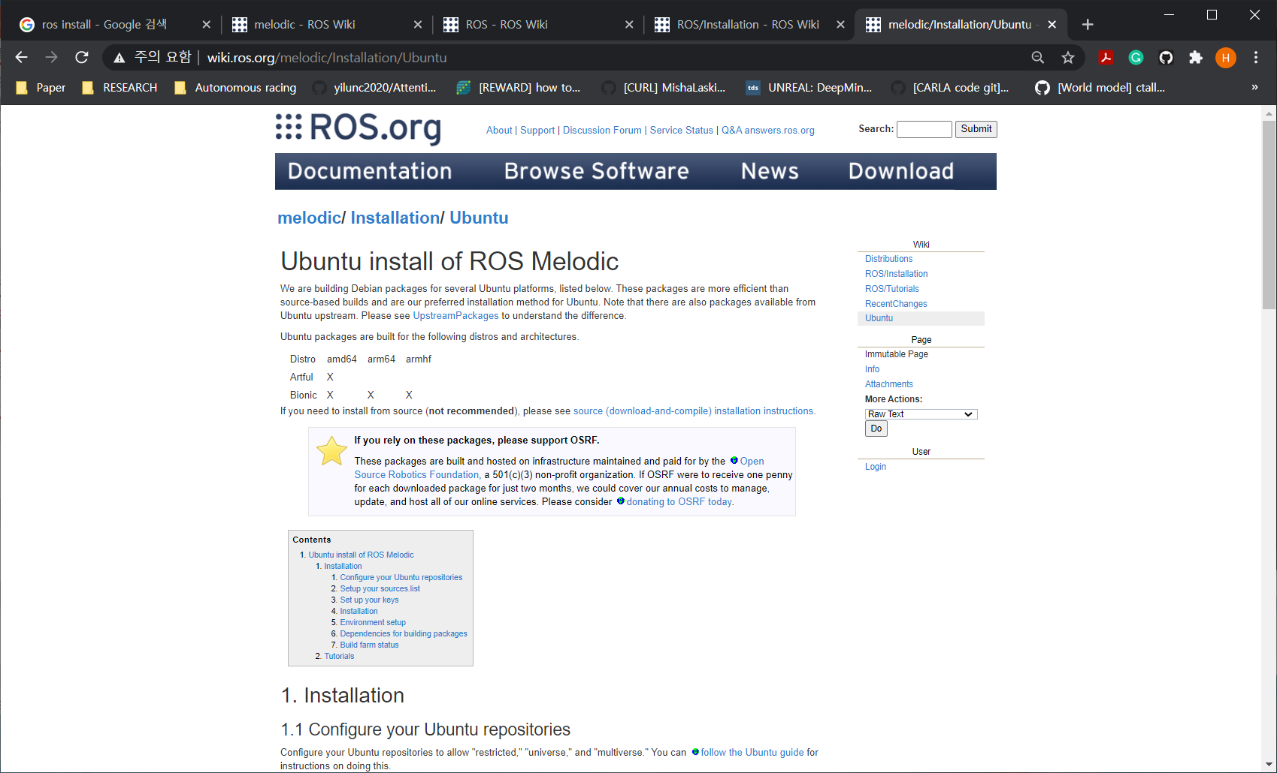
Installation & Configuration of ROS
Simply follow the homepage installation tutorial.
Install homepage: http://wiki.ros.org/ROS/Installation.
22

Slide 23
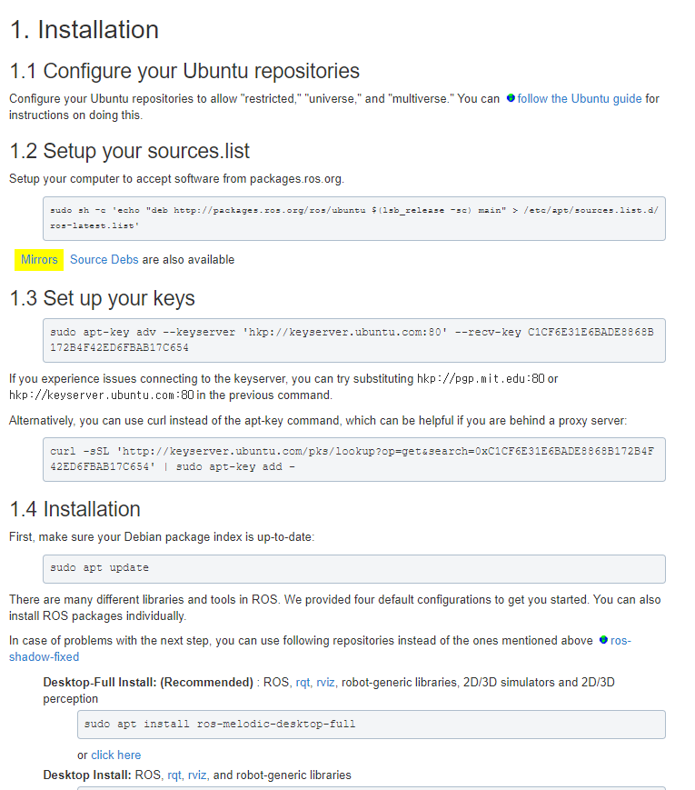
Installation & Configuration of ROS
Reference : http://wiki.ros.org/melodic/Installation/Ubuntu
Setup your sources.list
sudo sh -c 'echo "deb http://packages.ros.org/ros/ubuntu $(lsb_release -sc) main" > /etc/apt/sources.list.d/ros-latest.list'
Set up your keys
sudo apt-key adv --keyserver 'hkp://keyserver.ubuntu.com:80' --recv-key C1CF6E31E6BADE8868B172B4F42ED6FBAB17C654
Update your Ubuntu package index
sudo apt update
Desktop-Full install
sudo apt install ros-melodic-desktop-full
23

Slide 24
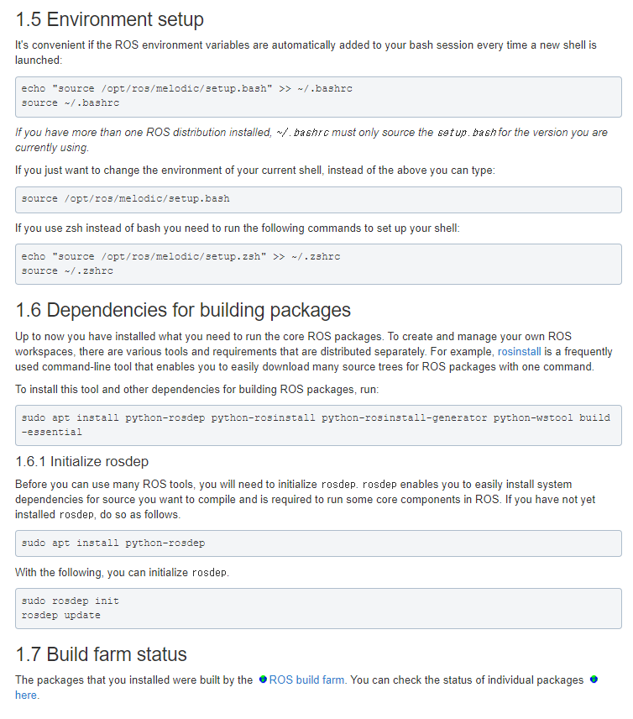
Installation & Configuration of ROS
Reference : http://wiki.ros.org/melodic/Installation/Ubuntu
Environment setup
echo "source /opt/ros/melodic/setup.bash" >> ~/.bashrc
source ~/.bashrc
You can check the above added line as below
gedit ~/.bashrc
※ ‘~/.bashrc’ is same with ‘/home/user/.bashrc’
Install dependencies for building packages
sudo apt install python-rosdep python-rosinstall python-rosinstall-generator python-wstool build-essential
Initialize rosdep
sudo apt install python-rosdep
sudo rosdep init
rosdep update
24

Slide 25
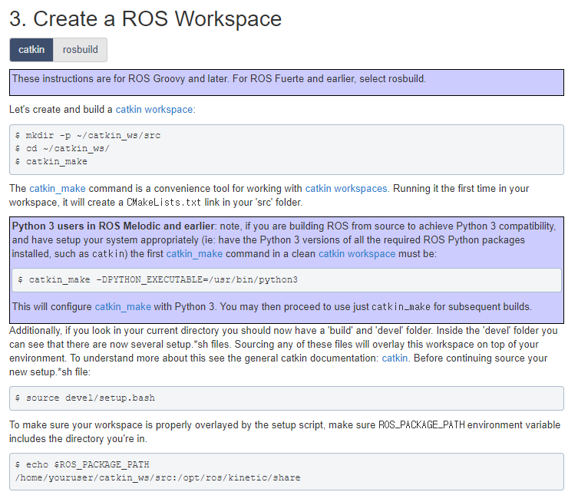
Installation & Configuration of ROS
Reference : http://wiki.ros.org/ROS/Tutorials/InstallingandConfiguringROSEnvironment
Create and build a catkin workspace (~/catkin_ws)
cd ~
mkdir –p ~/catkin_ws/src
cd ~/catkin_ws
catkin_make
“go to home directory”
“make a workspace (catkin_ws) and source (src) directory ”
“go back to workspace”
do catkin_make”
※ ‘catkin_make’ command should be executed in workspace (~/catkin_ws), not src directory.
Sourcing the files in devel after catkin_make process
source devel/setup.bash
※ Usually, people add above line in ‘~/.bashrc’ so that they don’t need do ‘sourec devel/setup.bash’ every catkin_make process.
Open the bashrc file (gedit ~/.bashrc) and add the line (source devel/setup.bash) in it.
25

Slide 26
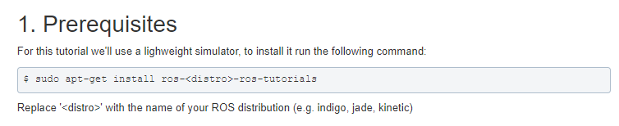
ROS Package Tutorial – TurtleSim
Reference : http://wiki.ros.org/ROS/Tutorials/UnderstandingNodes
Prerequisites
sudo apt-get install ros-melodic-ros-tutorials
or
sudo apt-get install ros-kinetic-ros-tutorials
“for Ubuntu 18.04”
“for Ubuntu 16.04”
Run roscore (in terminal 1)
roscore
Run tutorial ros package (in another terminal 2)
rosrun turtlesim turtlesim_node
※ rosrun [package_name] [node_name]
26

Slide 27
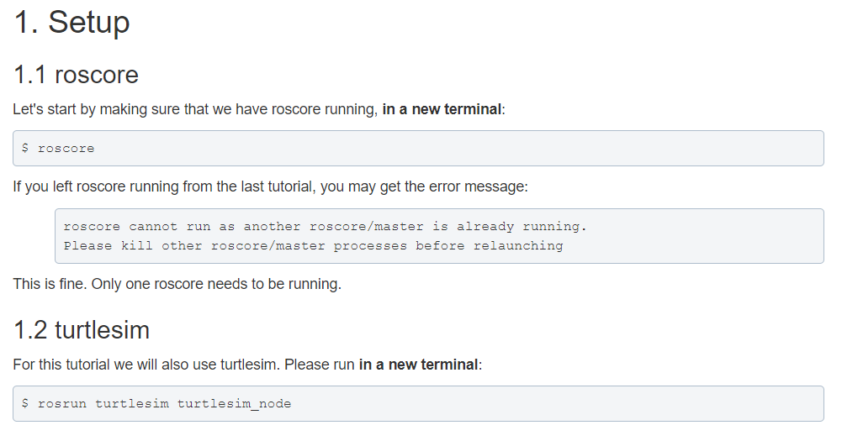
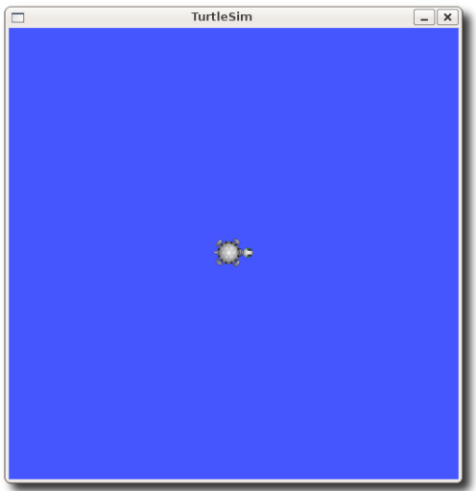
ROS Package Tutorial – TurtleSim
Reference : http://wiki.ros.org/ROS/Tutorials/UnderstandingNodes
Prerequisites
sudo apt-get install ros-melodic-ros-tutorials
or
sudo apt-get install ros-kinetic-ros-tutorials
“for Ubuntu 18.04”
“for Ubuntu 16.04”
Run roscore (in terminal 1)
roscore
Run tutorial ros package (in another terminal 2)
rosrun turtlesim turtlesim_node
※ rosrun [package_name] [node_name]
27

Slide 28
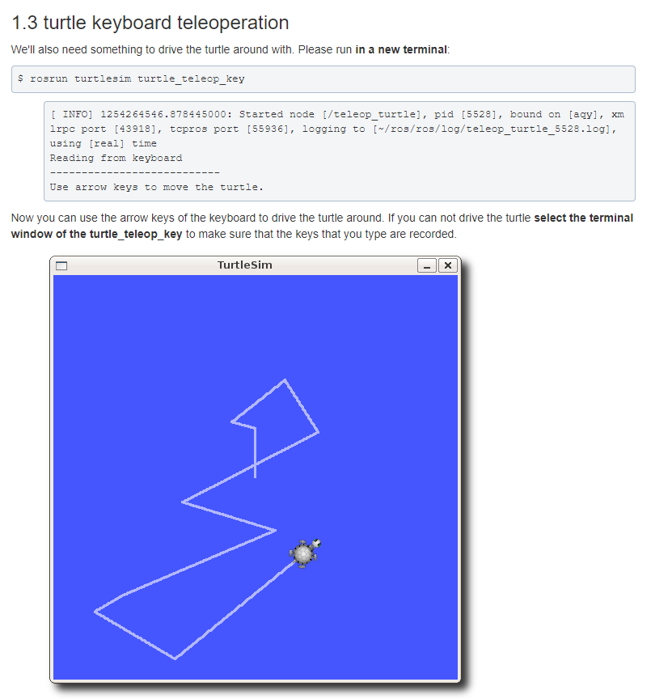
ROS Package Tutorial – TurtleSim
Reference : http://wiki.ros.org/ROS/Tutorials/UnderstandingTopics
Run turtle keyboard package (in a new terminal 3)
rosrun turtlesim turtle_teleop_key
You can use the arrow keys of keyboard to drive the turtle around!
28

Slide 29
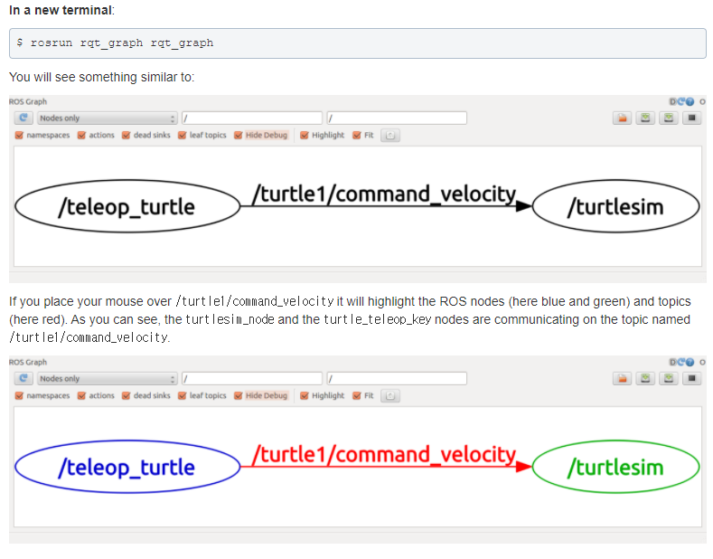
ROS Topic
Reference : http://wiki.ros.org/ROS/Tutorials/UnderstandingTopics
Run rqt_graph for checking the nodes and topics currently running (in a new terminal 4)
rosrun rqt_graph rqt_graph
or simply
rqt_graph
You can see the name of the publisher node (/teleop_turtle) and subscriber node (/turtlesim)
“Topic message”
“Node(Publisher)”
“Node(Subscriber)”
The topic message name (/turtle1/command_velocity) is represented as an arrow from the publisher to subscriber
29

Slide 30
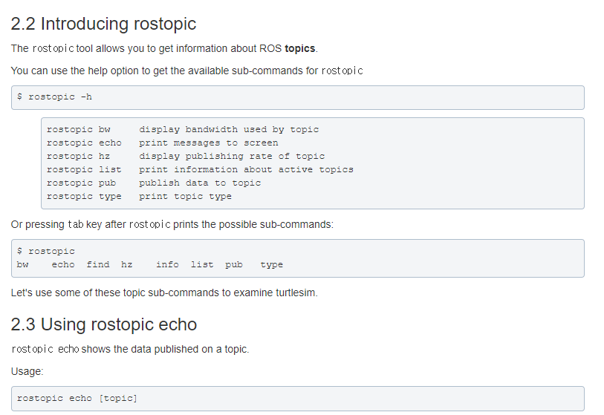
ROS Topic
Reference : http://wiki.ros.org/ROS/Tutorials/UnderstandingTopics
“rostopic” allows you to get information about ROS topics
rostopic list : print the list of active topics
rostopic echo : print messages of specific topic
rostopic pub : publish message data to topic
rostopic type : print message type of specific topic
rostopic hz : display publishing rate of topic
※ In order of frequent use
30

Slide 31
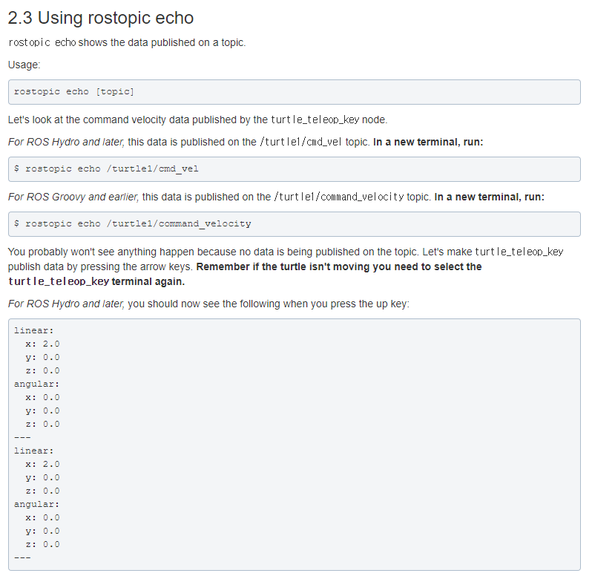
ROS Topic
Reference : http://wiki.ros.org/ROS/Tutorials/UnderstandingTopics
Use “rostopic echo” for displaying the command velocity topic from the turtle keyboard package, turtle_teleop_key.
rostopic echo /turtle1/cmd_vel
※ rostopic echo {topic_name}
When you press the arrow keys, you will see the message published from the turtle_teleop_key package.
linear:
x: 2.0
y: 0.0
z: 0.0
angular:
x: 0.0
y: 0.0
z: 0.0

Slide 32
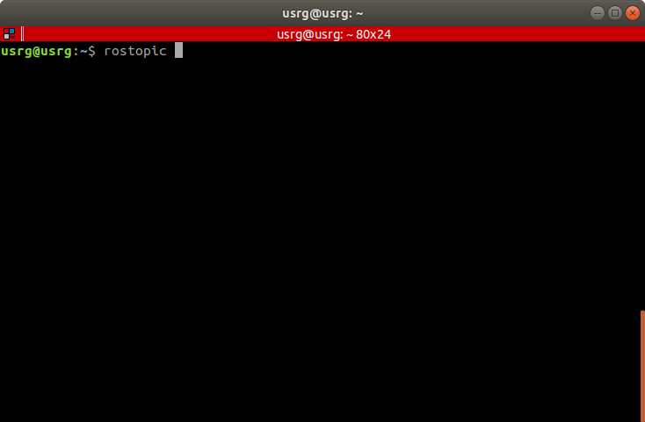
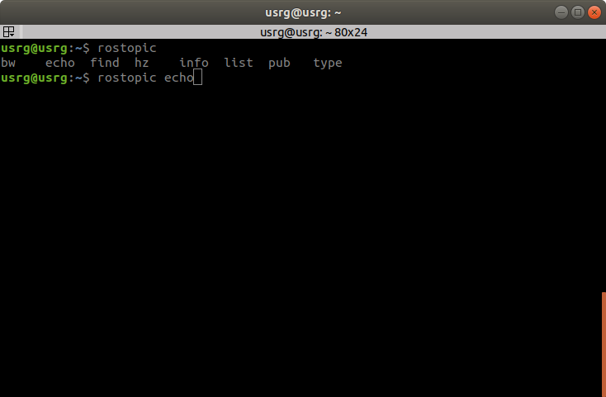
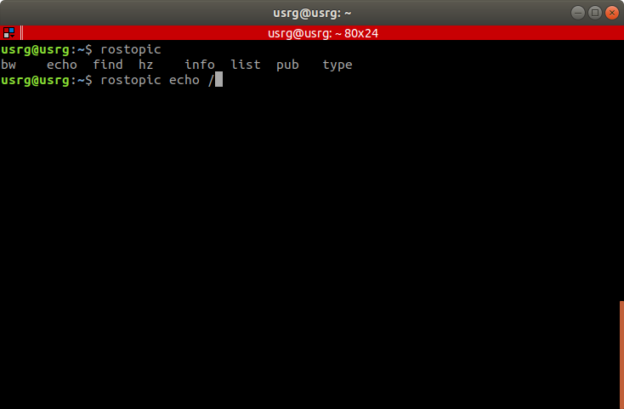
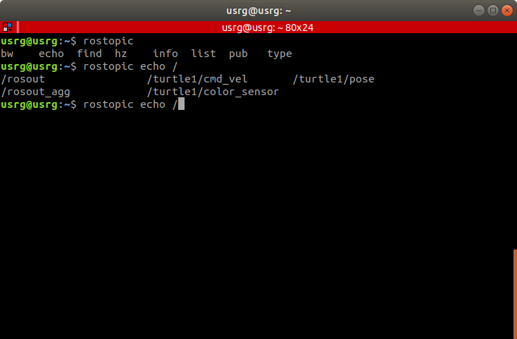
ROS Commands
roscore : run the ROS Master Node.
rosrun [package_name] [node_name] : run a ROS package node.
- rosrun turtlesim turtle_sim_node
- rosrun turtlesim turtle_teleop_key
Do not need to memorize commands.
Just use double ‘Tap key’ to display available commands or auto complete.
rostopic : allows you to get information about ROS topics.
Double ‘Tap’
- rostopic -h : display the sub-commands for ‘rostopic’.
(bw, echo, find, hz, info, list, pub, type)
- rostopic list : print information about active topics.
- rostopic echo [topic_name] : print messages to screen.
- rostopic pub [topic_name] [message_type] [data]
: publish data to topic.
Double ‘Tap’
Double ‘Tap’

Slide 33
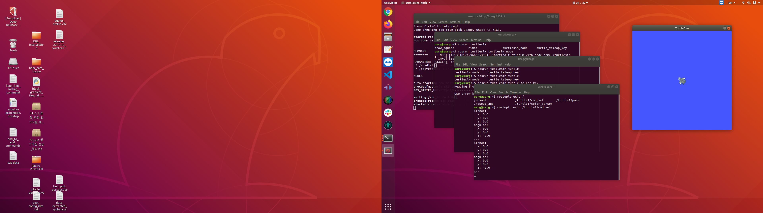
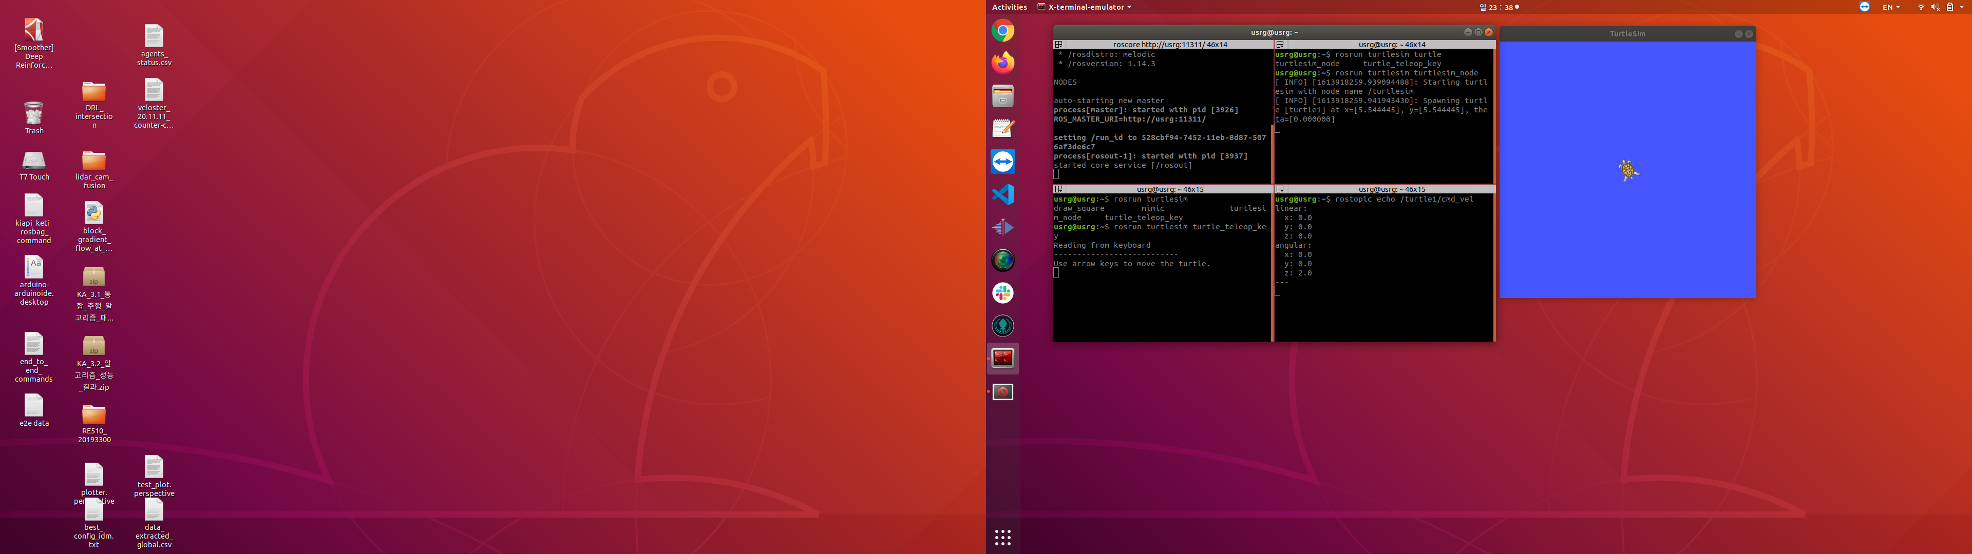
Tips – Terminator
Recommend Terminal Program in Ubuntu: Terminator
In many case, programmer needs to process multiple programs in Ubuntu.
Opening new terminal window whenever you need to run new one is inconvenient.
Terminator has a function to split a terminal window so that we can run multiple programs in one window.
Installation:
sudo apt-get install terminator
Default Terminal Windows
Terminator window

Slide 34
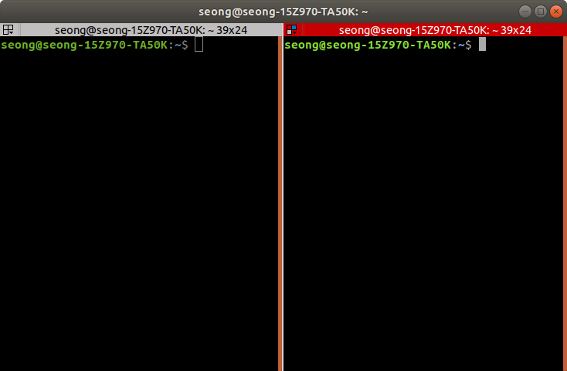
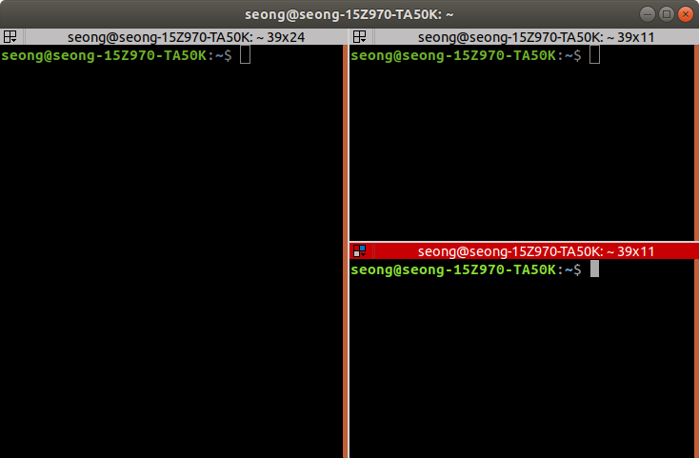
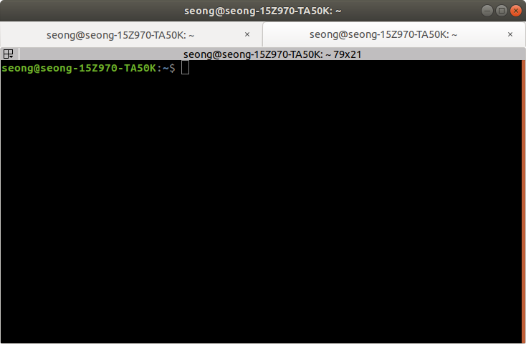
Tips – Terminator
Recommend Terminal Program in Ubuntu: Terminator
Ctrl + Alt + T : open a terminal window (same with default terminal of Ubuntu).
Ctrl + Shift + E : split terminal window vertically.
Ctrl + Shift + O : split terminal window horizontally.
Ctrl + Shift + T : add new terminal window tab.
→ Convenient to run and control multiple ros packages in one window!
Ctrl + Shift + E
Ctrl + Shift + O
Ctrl + Shift + T

Slide 35
Experiment Summaries
Get brief tips on installing Ubuntu(Linux-based OS).
Linux installation by Dual Boot is recommended.
Understand the Robotics Operating System (ROS).
Important terminologies : Publish / Subscribe / Topic
Install & Setup ROS.
Follow the homepage installation tutorial
Run ROS tutorial.
Demonstrate the Turtlesim simulator to be familiar with the ROS system.
35

Slide 36
Experiment Objectives
Next week, you will do the following:
Understand how to use the ROS Tools (rviz, rosbag)
Learn ROS Programming
Programming Assignment :
Programming ROS topic publisher & subscriber.
Use ‘roslaunch’ to run your publisher & subscriber node together.
Class Hours (TA Session)
: Online experiment class by TAs: Wednesday(7~8:30pm)
※ Offline experiment will be determined soon.
36

Slide 37
Q & A
Email : hynkis@kaist.ac.kr
37

